Slide 1

CUSTOMER CHURN PREDICTION IN TELECOM INDUSTRY

Slide 2
CONTENTS
Aim
Model Building Steps
Introduction
Data Collection & Description
Exploratory Data Analysis
Data Visualization
Feature Engineering
Splitting the data into training & testing
Accessing multiple algorithms
Model Deployment
Recommendations
Conclusion

Slide 3
AIM
To Predict the customer churn among Telecom industry
Framing out key variables used for churn prediction.
Usage of machine learning models to build, evaluate and predict the customer churn.
Estimating optimal machine learning model for customer churn.
Finding out the best model for our business case & providing executive summary.

Slide 4
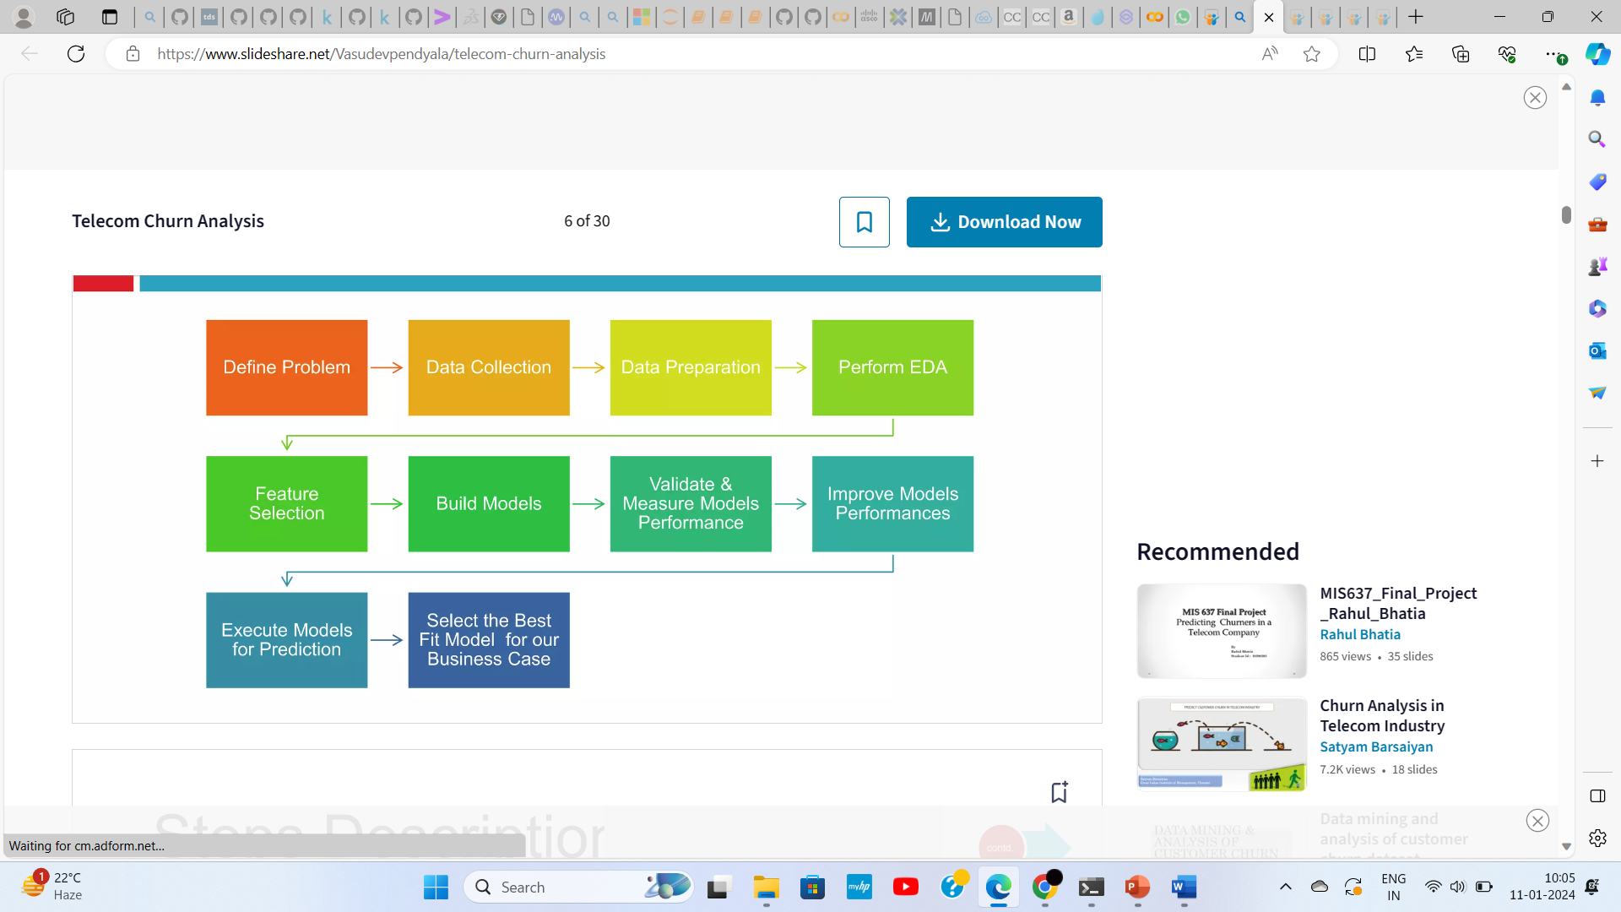
MODEL BUILDING STEPS

Slide 5
INTRODUCTION
Problem Statement
For this project, we have obtained a longstanding telecom customer dataset of a telecom
(Mobile) company which aims to predict whether its customers will churn or not.
Churn
Term used to describe customer attrition or loss
Churn Rate
The number of participants who discontinue their use of a service divided by the total
number of total participants at the start of the period.

Slide 6
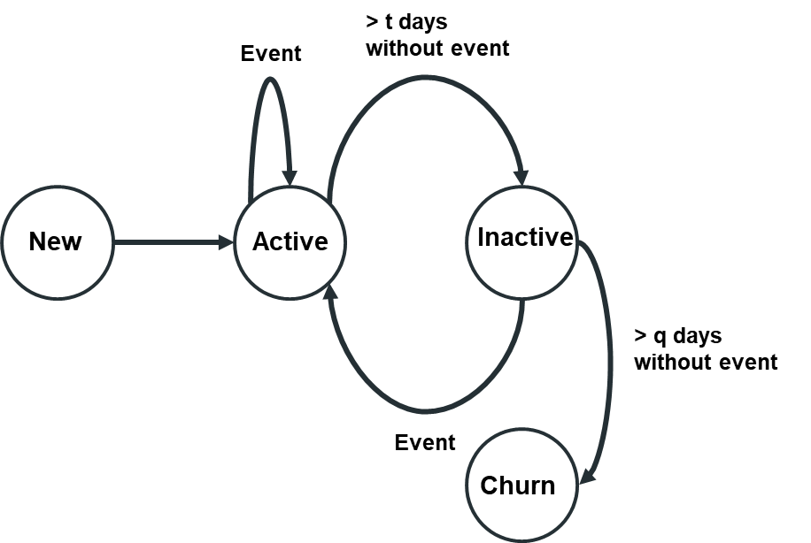
Reasons for churn
Easy to switch provider
Difficult to manage the customer data
Inadequate services
Bad quality of service
Customer dissatisfaction

Slide 7
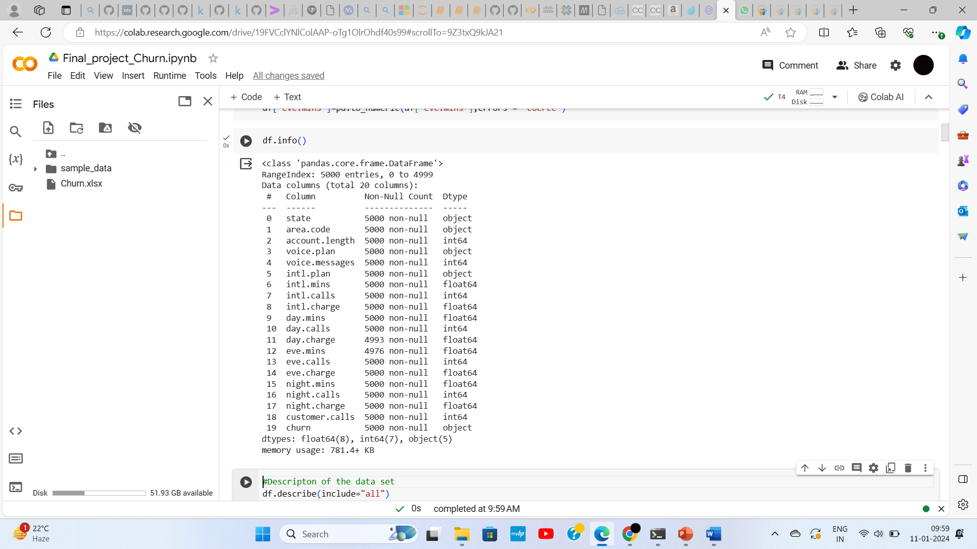
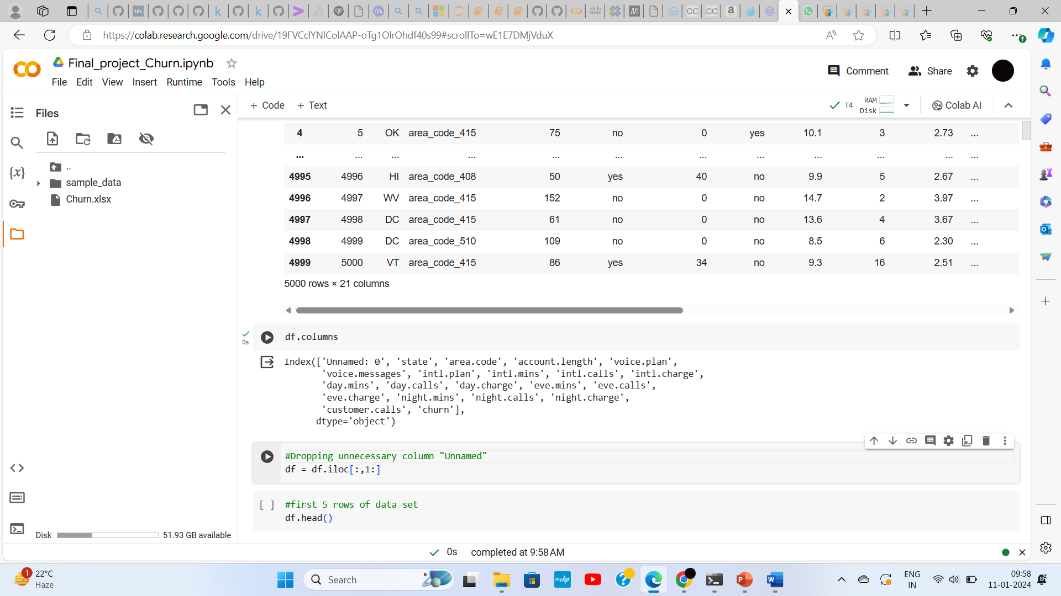
DATA COLLECTION & DESCRIPTION
Source Data set is in CSV format.
The source dataset is basically comma separated variable.
Data set contains 5000 rows and 21 columns.
Churn is a variable which notifies weather a particular person is churned or not. And we will be deploying our models to predict this variable only.

Slide 8
EXPLORATORY DATA ANALYSIS(EDA)
An approach to analyse the data sets & to summarise their main characteristics, often with the visual methods.
Used for seeing what the data can tell us beyond the formal modelling or hypothesis.
Helps to evaluate the presence of outliers and its effect.
Here we perform:
i. Missing values and data types
ii. Removing unwanted columns
iii. Checking and handling Outliers(through mean or median or upper extreme, lower extreme)
iv. Descriptive Analysis
v. Checking and handling the null values
vi. Checking and handling duplicate values.

Slide 9
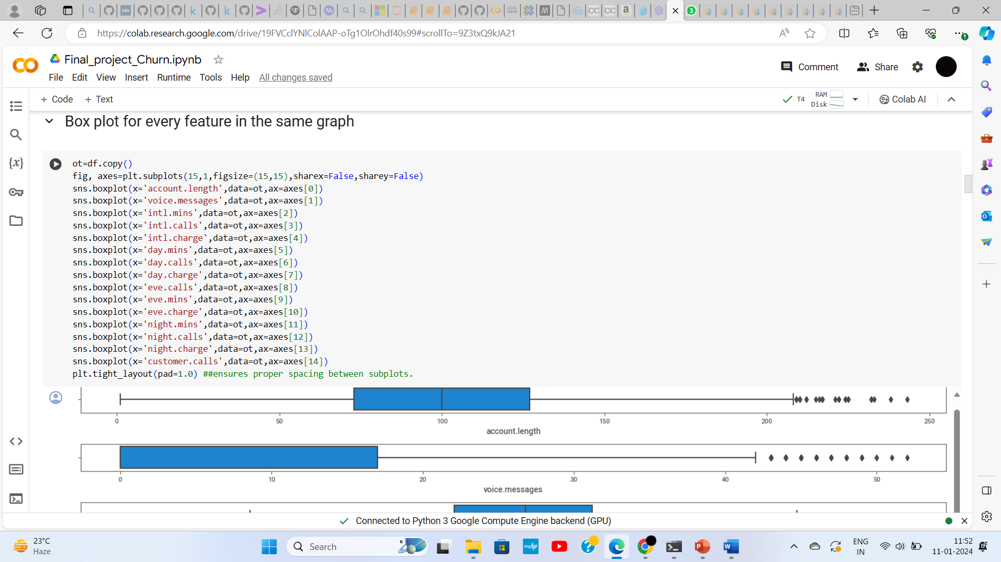
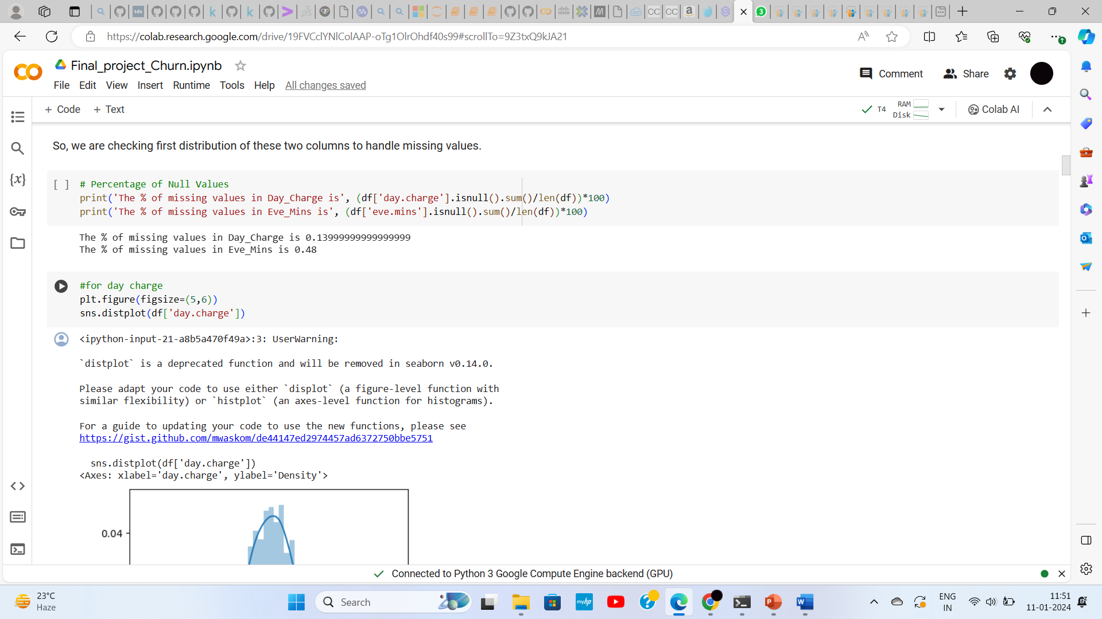
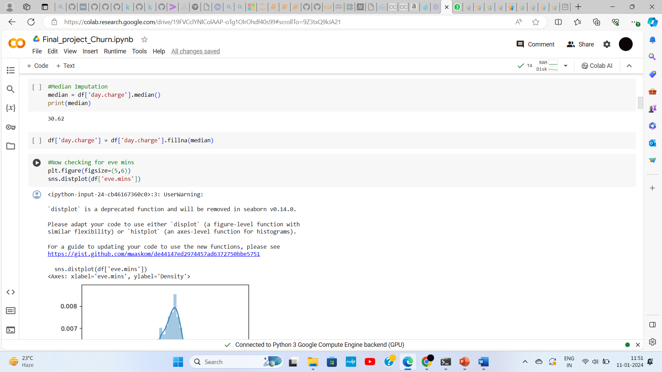
HANDLING NULL VALUES
CHECKING OUTLIERS USING BOXPLOT

Slide 10
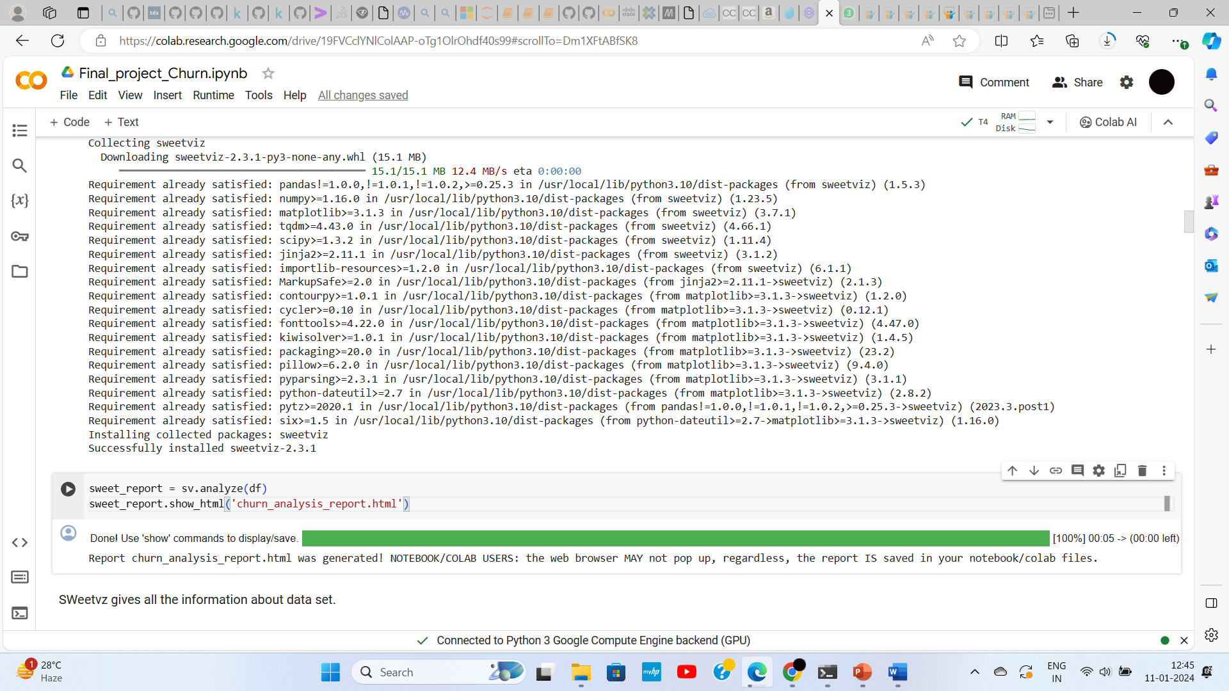
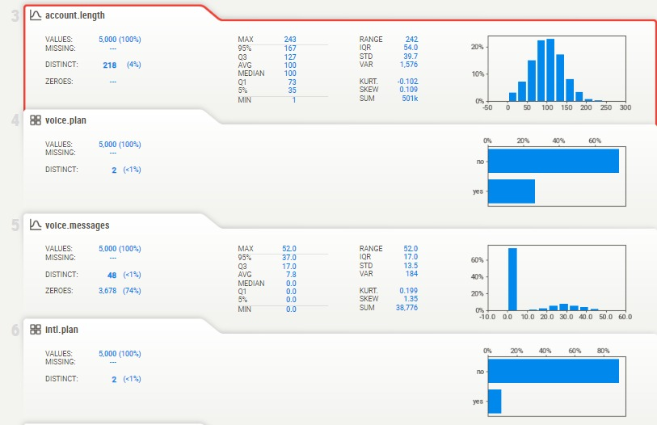
DATA VISUALIZATION Understand how the data and features are interrelated and corelated and for better visualisation Library used: Sweetviz (gives detailed information about each column.) Here we perform: i. Response variable(Bar plot) ii. Pie Plot iii. Density plot iv. Histogram plot v. Pair plot vi. Catplot vii. Heatmap viii. Countplot

Slide 11
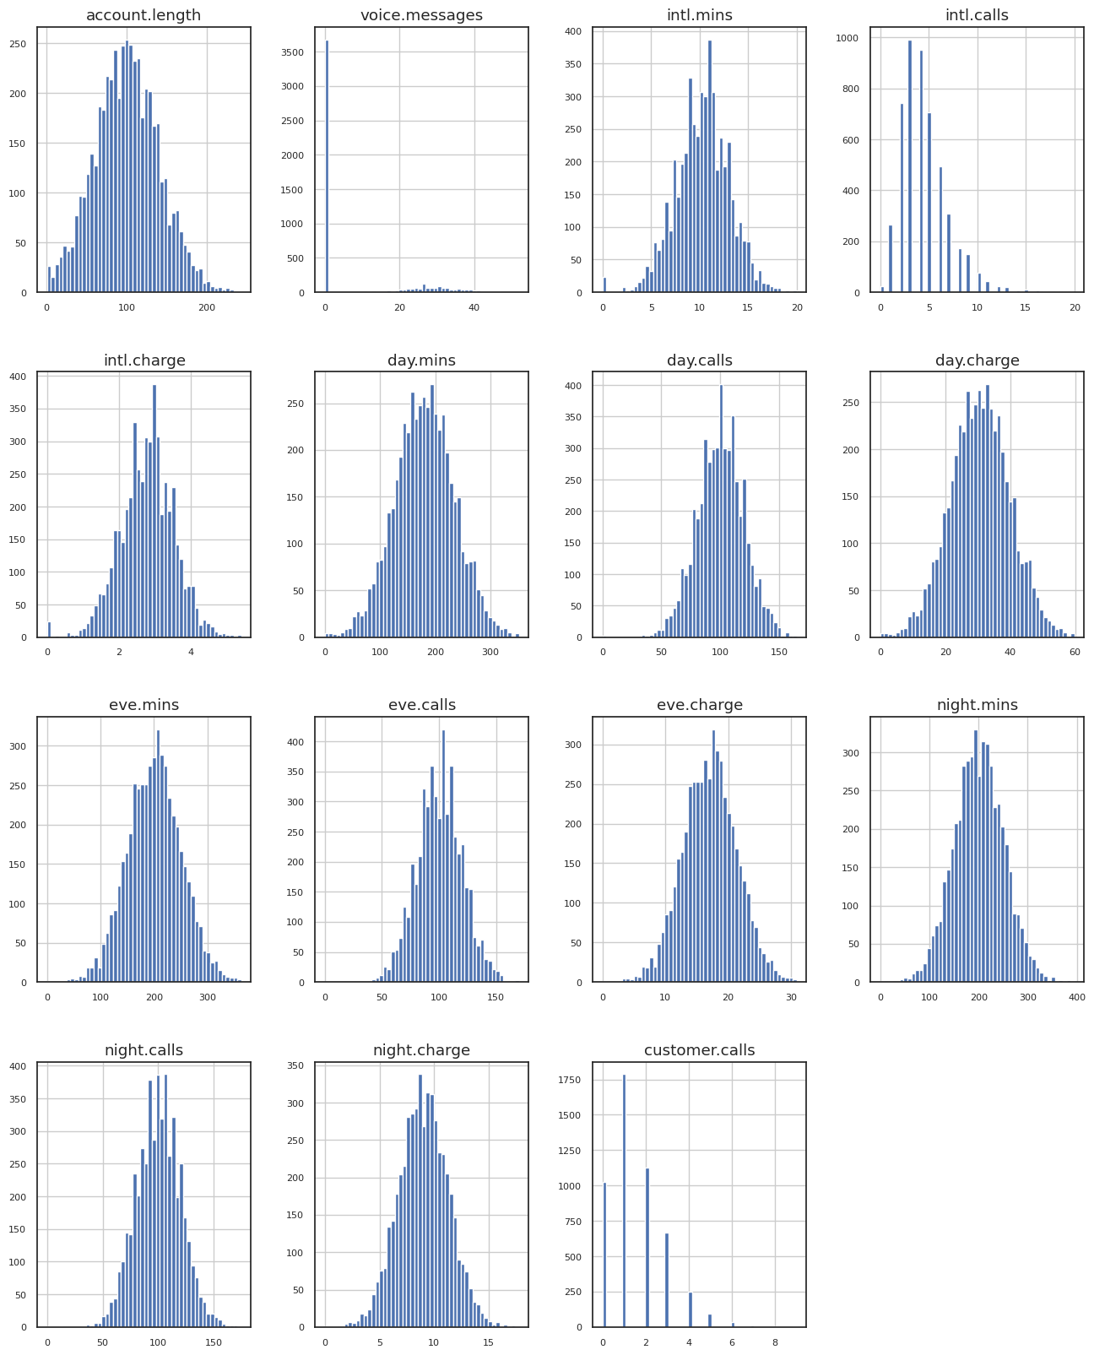
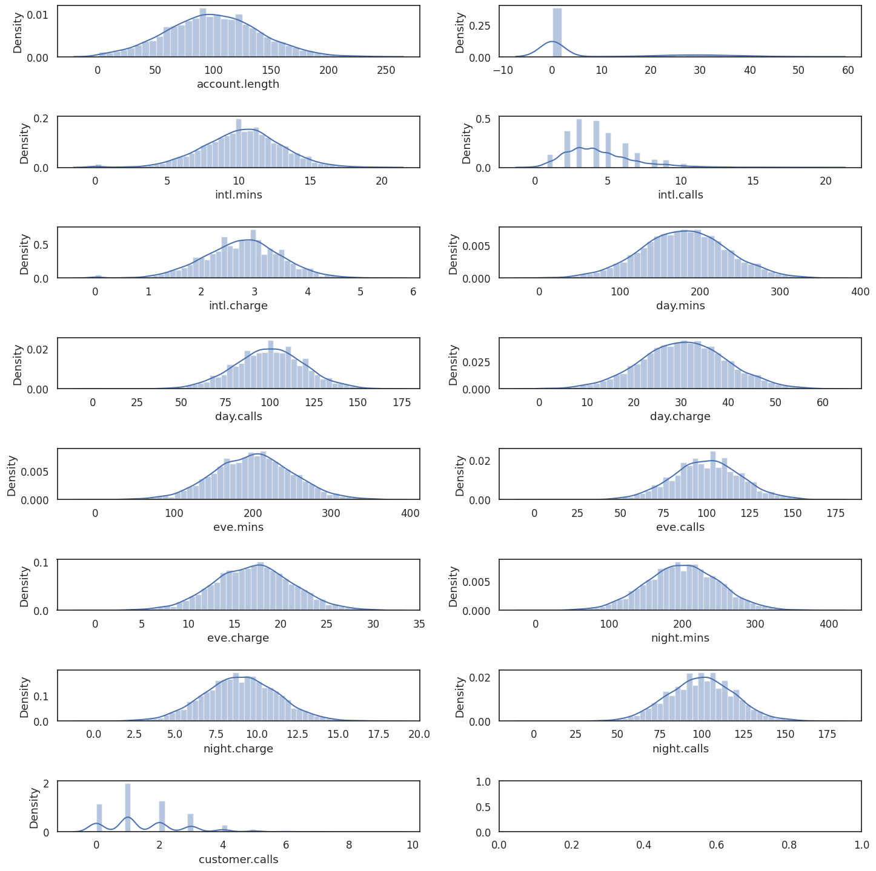
Histogram
Density Plot
Description of distribution of the columns.
Conclusion : All the columns are normally distributed but the voice.messages, intl.calls and customers.calls are not normally distributed.

Slide 12
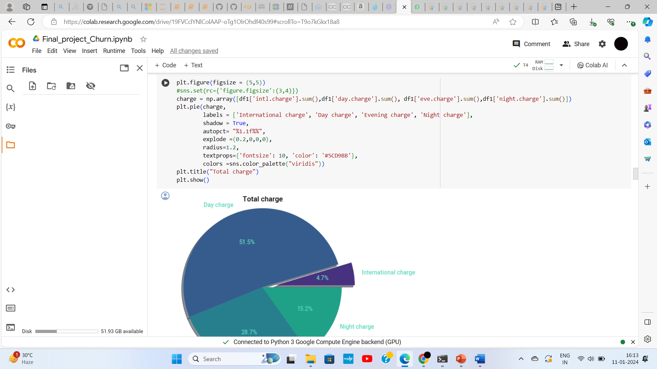
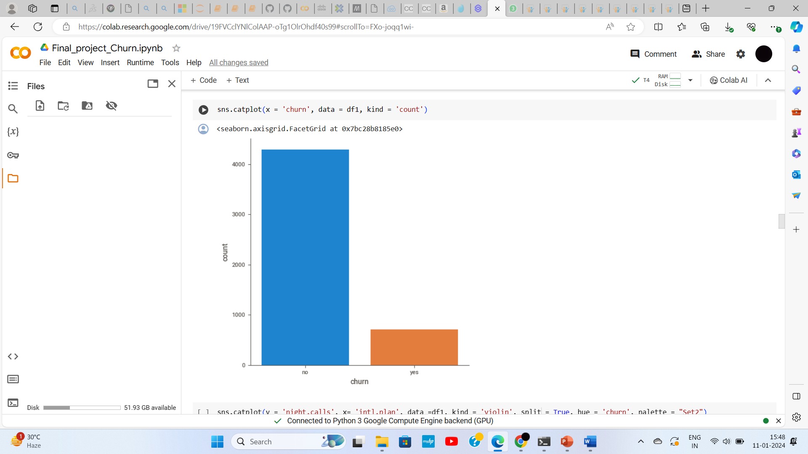
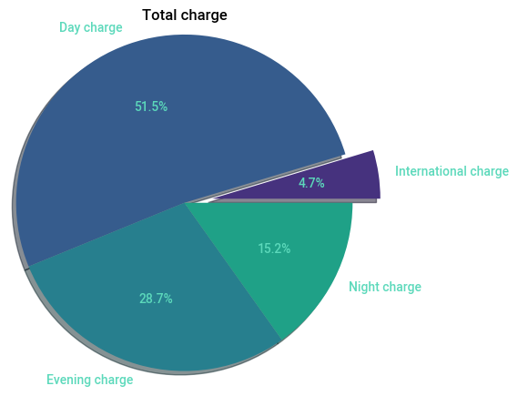
Pie Plot
Information regarding total charge services and the charge percentage in each charge service
Conclusion: Day charges are more compared to others
85.9% customers are continuing their subscription and 14.1% customers disconnected

Slide 13
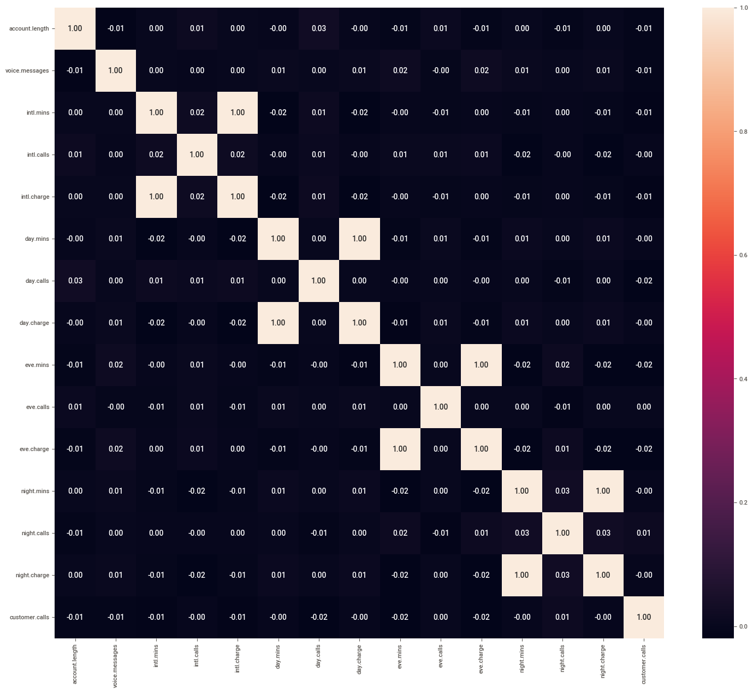
Helps to understand the interdependency between variables.
Correlation Matrix

Slide 14
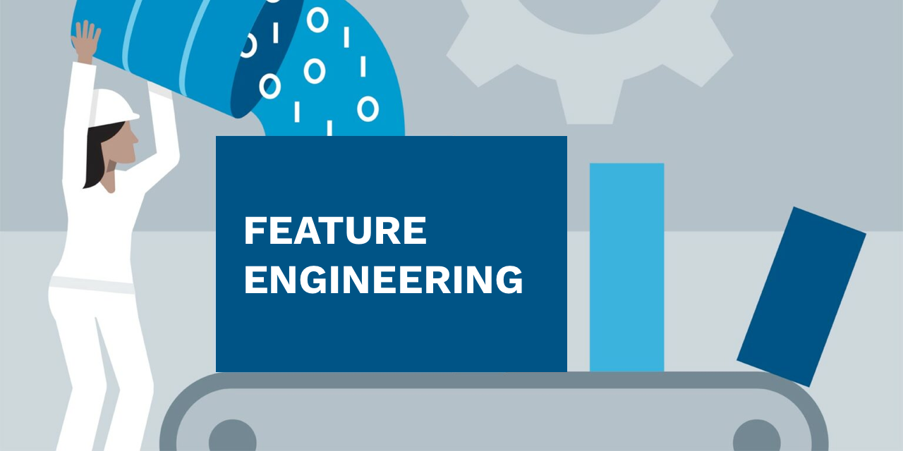
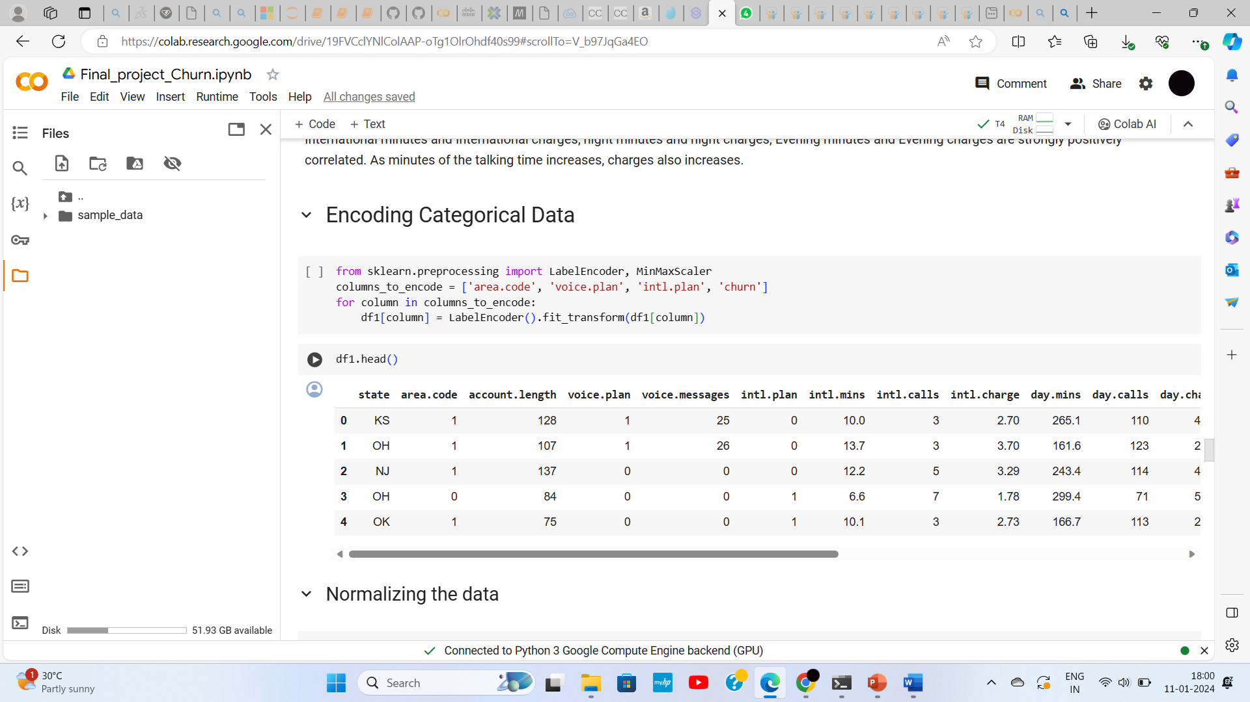
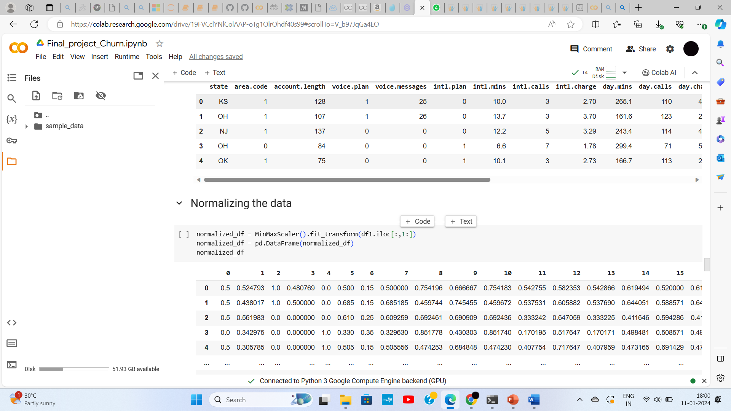
FEATURE ENGINEERING
The process of transforming raw data into a format that is more suitable for machine learning models.
Significantly impacts the performance of a model.
Label Encoder is used to convert categorical variables into numerical format.
MinMaxScaler is used to normalize the data to rescale numeric column to a fixed range of [0,1].

Slide 15
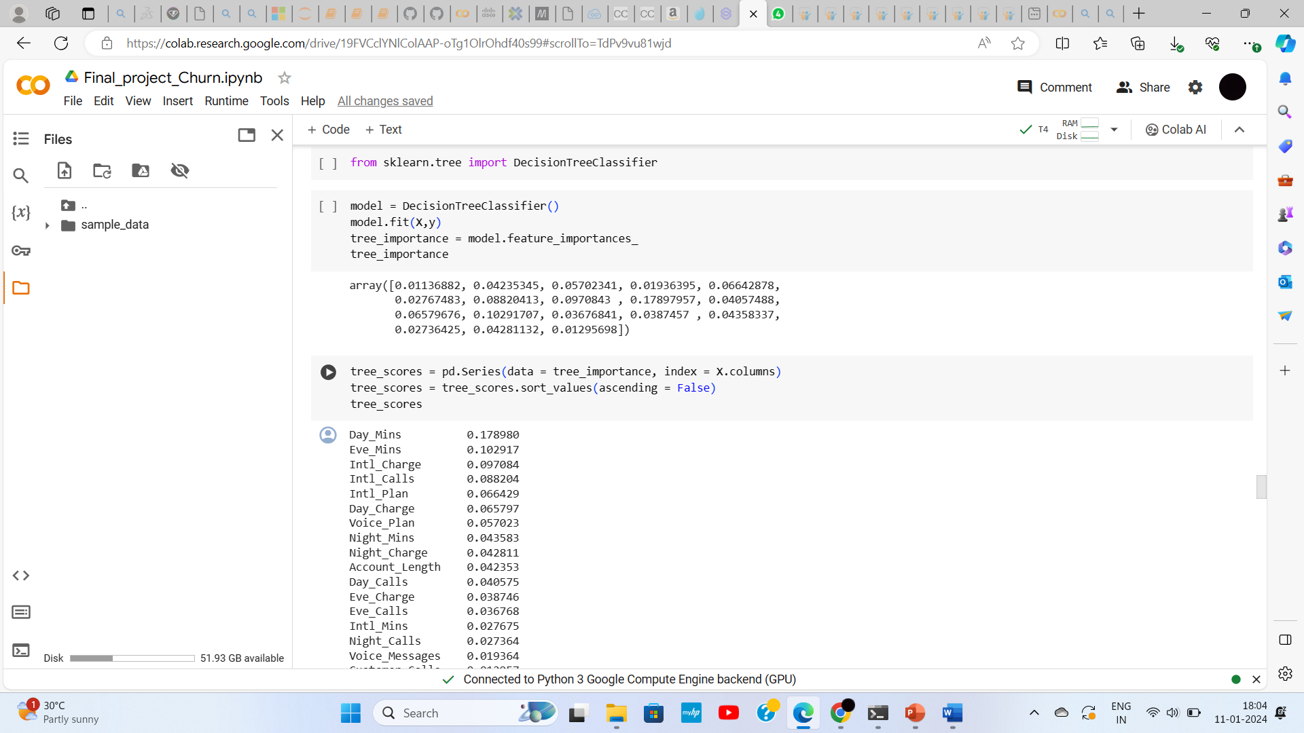
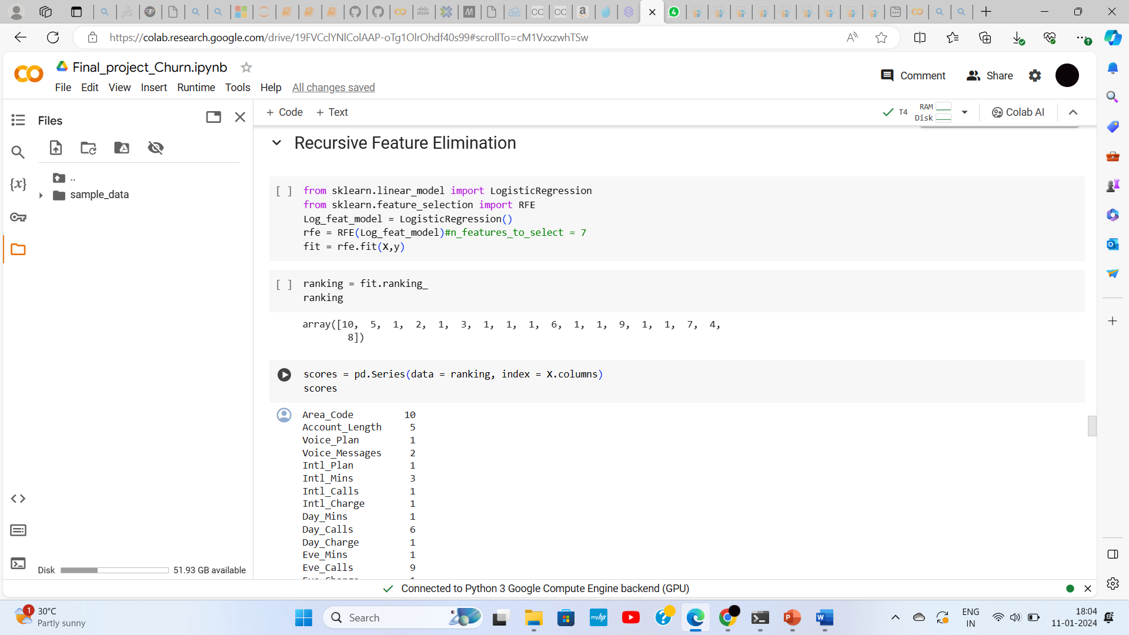
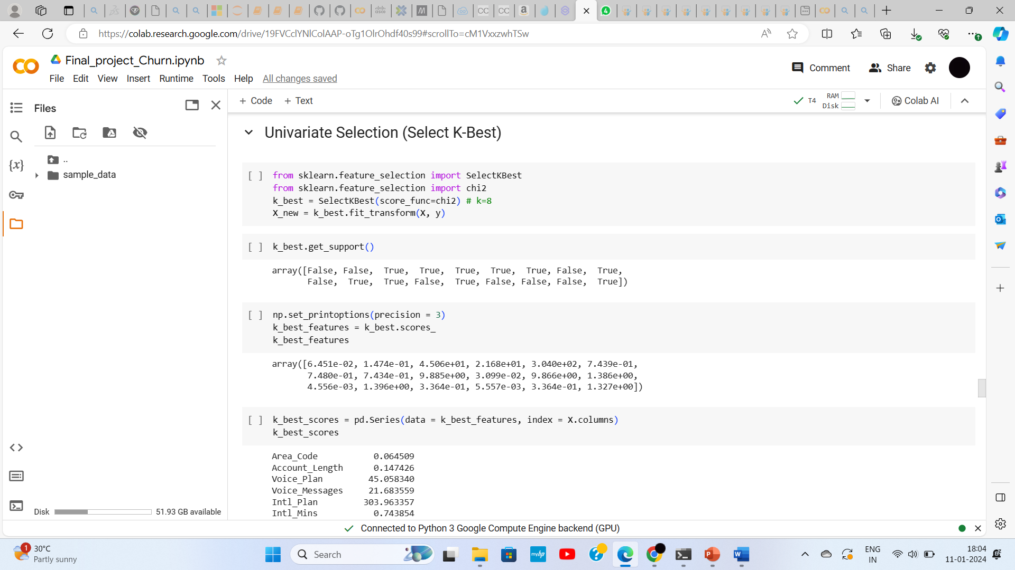
3 Methods used for feature selection
Decision Tree
Recursive Feature Elimination
Select K-Best

Slide 16
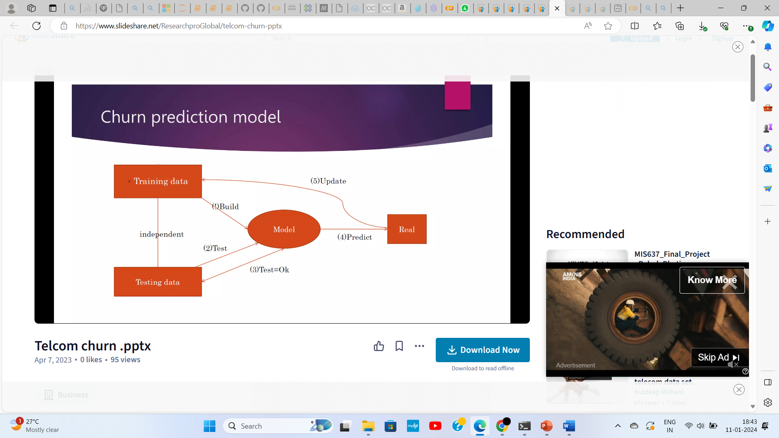
SPLITTING THE DATA INTO TRAINING & TESTING
Data Splitting: Training and Testing sets.
Training Set: Utilized by the machine learning algorithm for model construction.
Test Set: Comprises samples not used in the learning process and used for accessing model performance.
Variable Creation: Creation of a variable X to store independent variables.
Target Variable: Creation of a variable y to store the target variable, which is "Churn.“
train_test_split function from the sklearn.model_selection package to create both the training and testing sets.

Slide 17
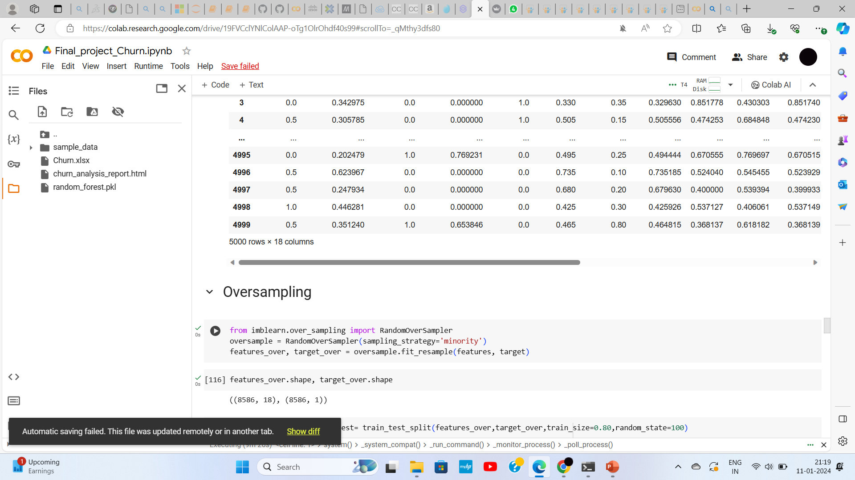
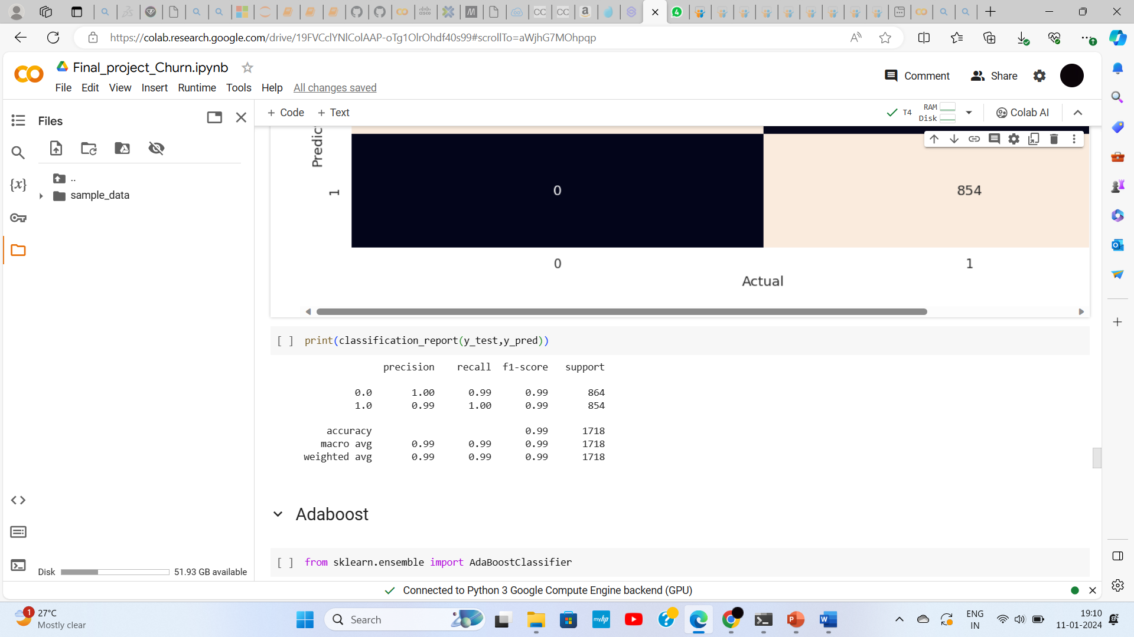
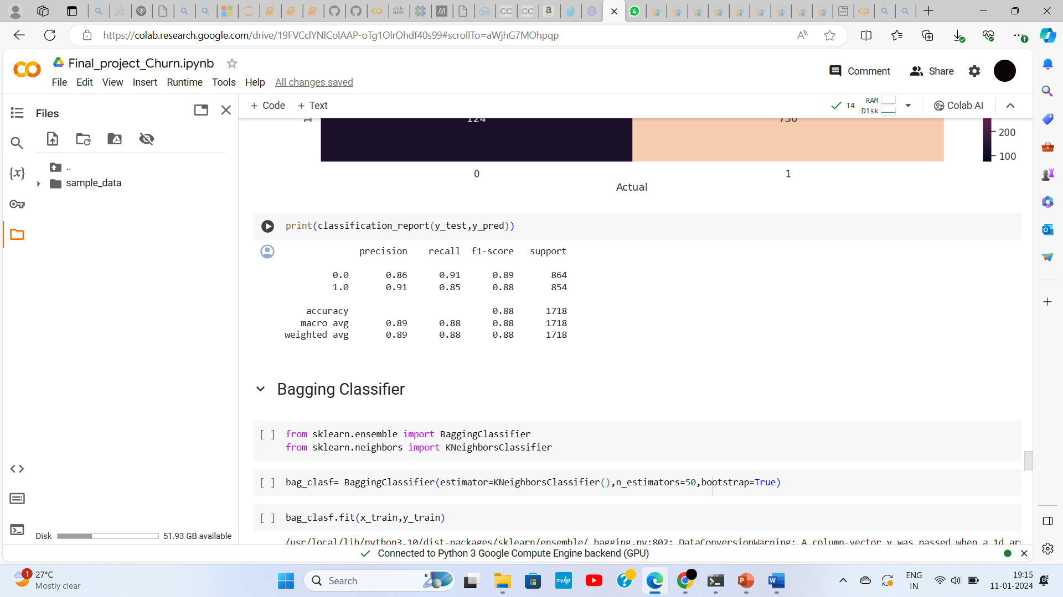
ACCESSING MULTIPLE ALGORITHMS
RANDOM FOREST
XG BOOST
RandomOverSampling is used for rebalancing the class distribution for an imbalanced data set.

Slide 18
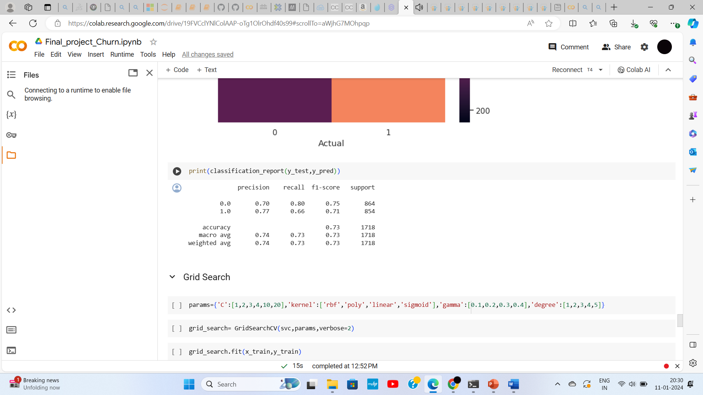
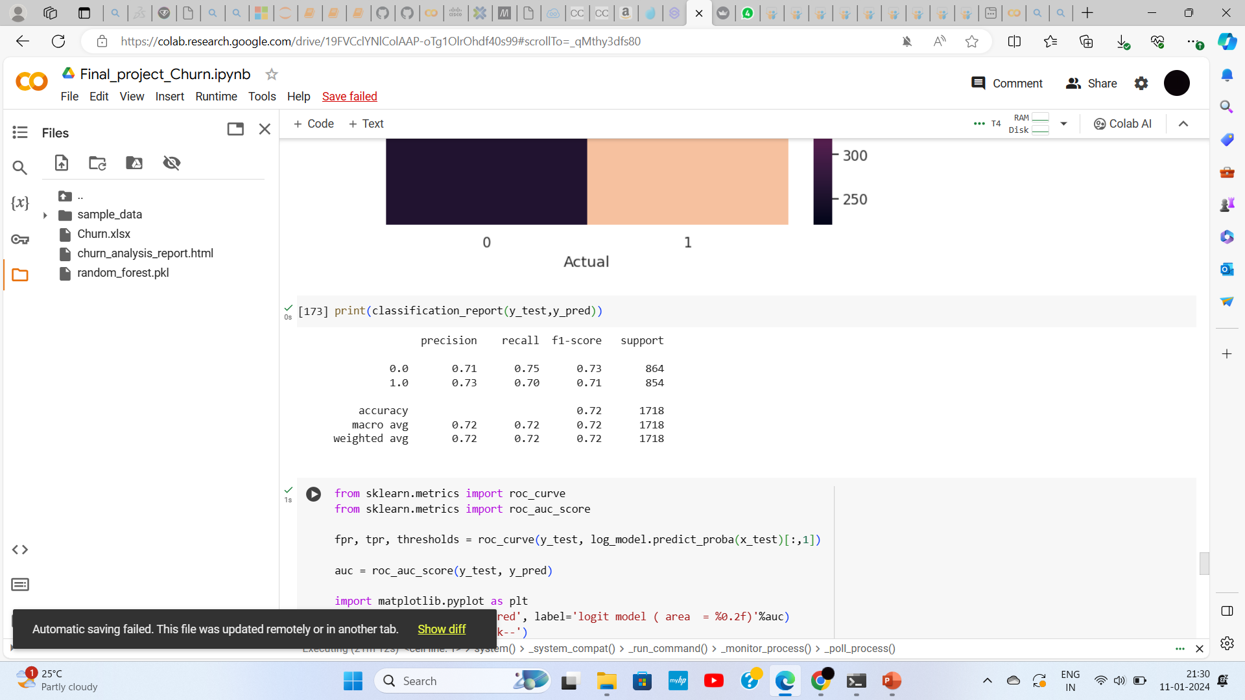
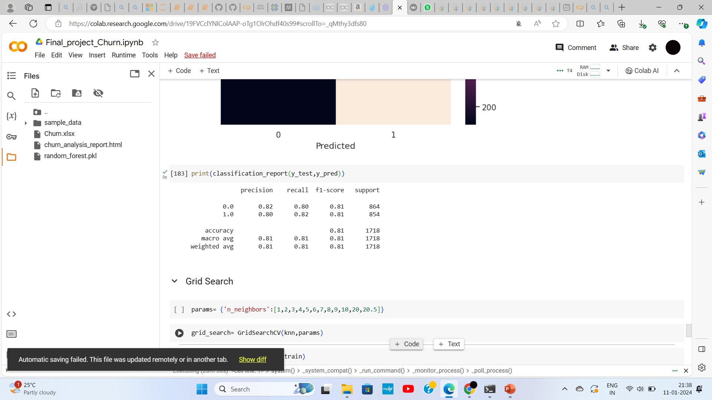
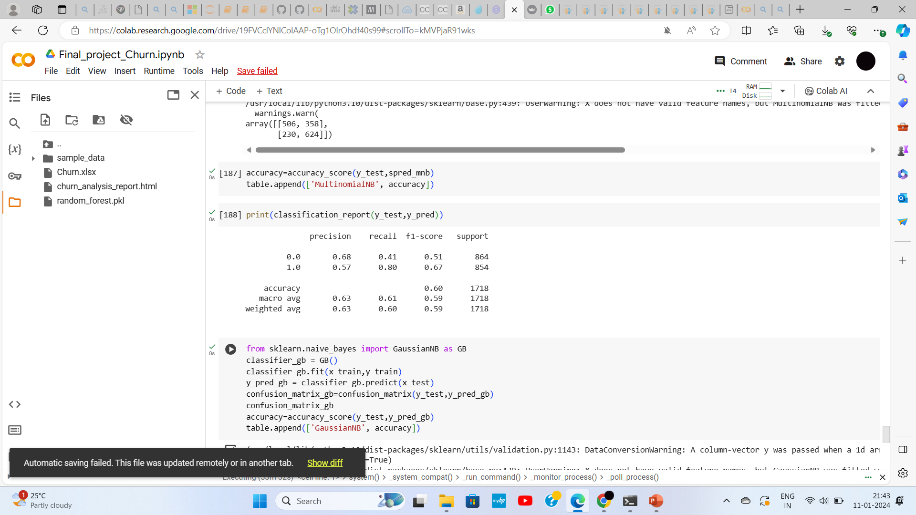
SVM
LOGISTIC REGRESSION
KNN
NAIVE BAYES(MULTINOMIALNB)

Slide 19
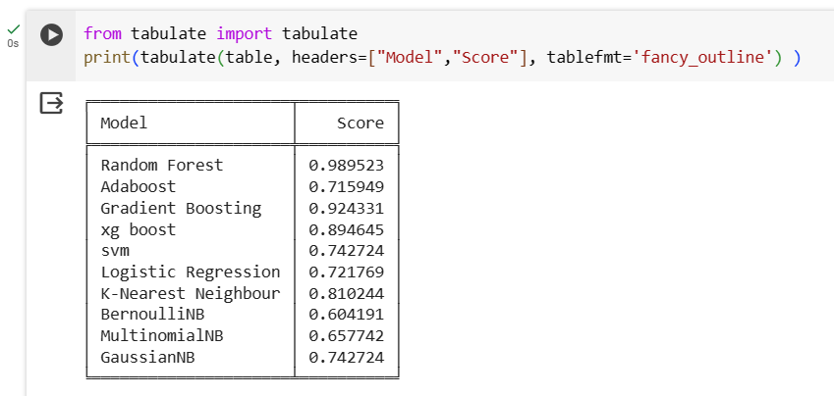
MODEL DEPLOYMENT Integration of Machine learning model into an existing production environment where the user can enter the input to generate output and later it can be used in making business decision.
Also best model has been predicted with best score was derived and made 98.95% accuracy
Random Forest algorithm is chosen for the telecom customer churn dataset.

Slide 20
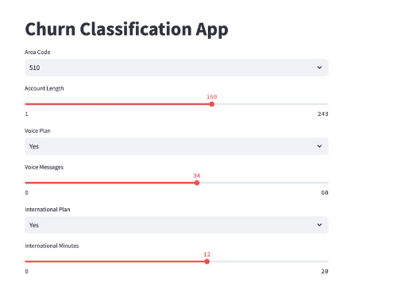
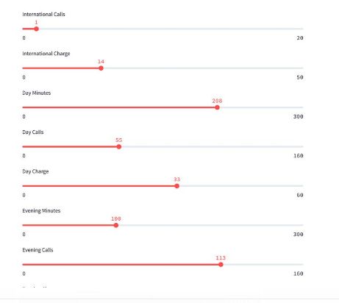
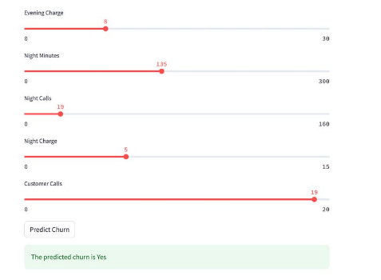
We used Streamlit framework to deploy the code instantly and see the changes simultaneously by saving the source code.

Slide 21
RECOMMENDATIONS
CONCLUSION
Offering better service for the customers.
Regular collection of feedback and surveys with the customer will reduce the churn.
Develop customer retention programs to reward loyal customers.
While taking the any change in plans, it is better to conduct a customer survey, to just predict the positive and negative share of that plan. If it is negative, it is best not to implement
Such research helps companies to become more profitable.
This research is aimed to build a system that predicts the customer churn in telecom company. These prediction models need to achieve high AUC values.
To test and train the model, the sample data is divided into 80% for training and 20% for testing.

Slide 22
Thank You

